Slide 1
Software Design

Slide 2
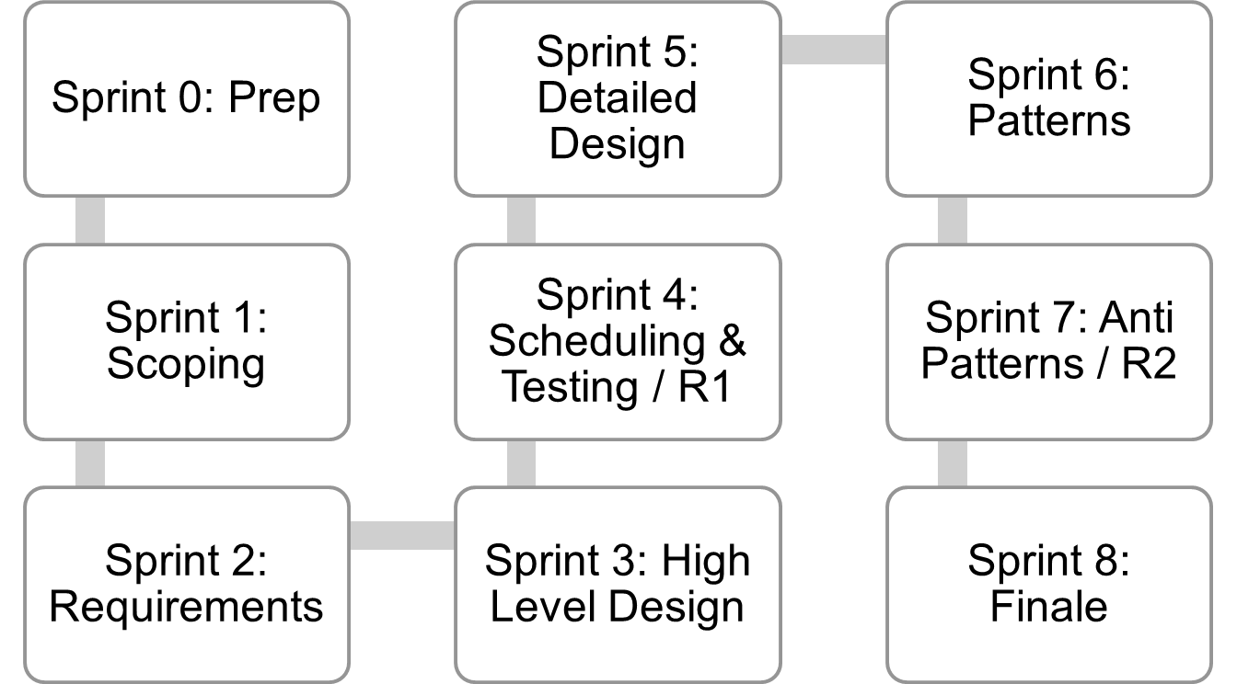
Where are we..
Jan 4
Mar 12
Mar 26
Lecture topics will follow this flow
As the projects tracks these sprints
Submissions due along the way
Guest lectures from startups and Industry leaders
EACH SPRINT IS 2 WEEKS, Friday start.
Jan 15
Feb 26
Apr 9
Jan 29
Feb 12
April 23
April 23+ EVALUATIONS

Slide 3
Architecture
Design
Classes
Behavioral
State models
These slides are designed to accompany Software Engineering: A Practitioner’s Approach, 7/e (McGraw-Hill, 2009) Slides copyright 2009 by Roger Pressman.

Slide 4
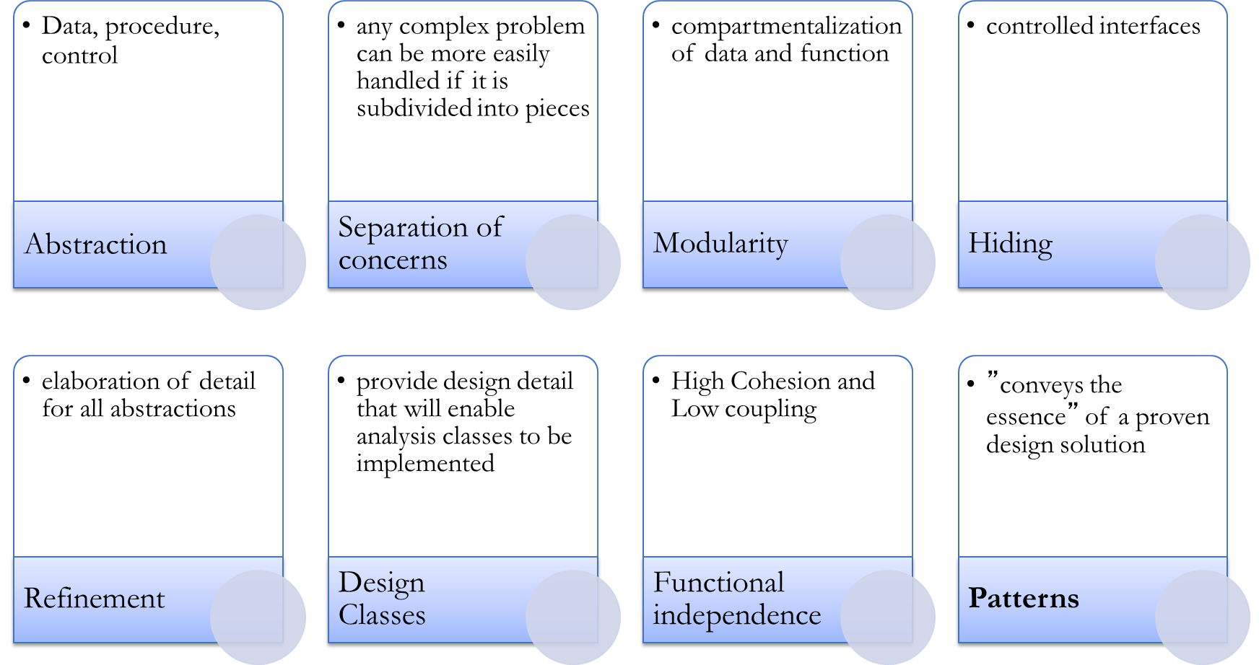
Key concepts
These slides are designed to accompany Software Engineering: A Practitioner’s Approach, 7/e (McGraw-Hill, 2009) Slides copyright 2009 by Roger Pressman.

Slide 5
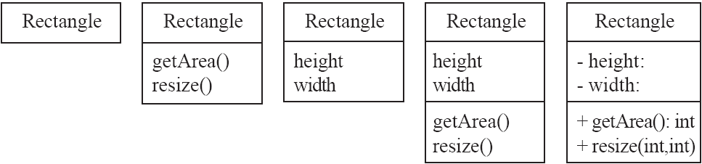
Classes
A class is simply represented as a box with the name of the class inside
  The diagram may also show the attributes and operations
  The complete signature of an operation is:
    operationName(parameterName: parameterType …): returnType
int
int
:void

Slide 6
Interfaces
An interface describes a portion of the visible behaviour of a set of objects.
  An interface is similar to a class, except it lacks instance variables and implemented methods
Person
«interface»
Cashier
Machine
Person
Machine
withdraw
deposit
Cashier
Cashier
Employee
ATM
Employee
ATM

Slide 7
Suggested sequence of activities
  Identify a first set of candidate classes
  Add associations and attributes
  Find generalizations
  List the main responsibilities of each class
  Decide on specific operations
  Iterate over the entire process until the model is satisfactory
    Add or delete classes, associations, attributes, generalizations, responsibilities or operations
    Identify interfaces
    Apply design patterns
    Don’t be too disorganized. Don’t be too rigid either!

Slide 8
Specifying behavior
Class models describe objects and their relationships
  Behavior can be specified in terms of operation pre and postconditions, but behavior is not the primary focus of a class model
Behavioral models in the UML
  State diagrams: describe control aspects of a system – provides descriptions sequences of operations without regard for what the operations do.
  Interaction models (Sequence diagrams): describe interactions among objects
Interaction diagrams are used to capture the behavior of a system. It displays the dynamic structure of a system.
Sequence diagrams are used to represent message flow from one object to another object.

Slide 9
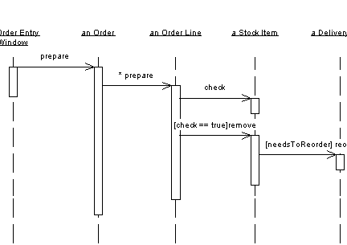
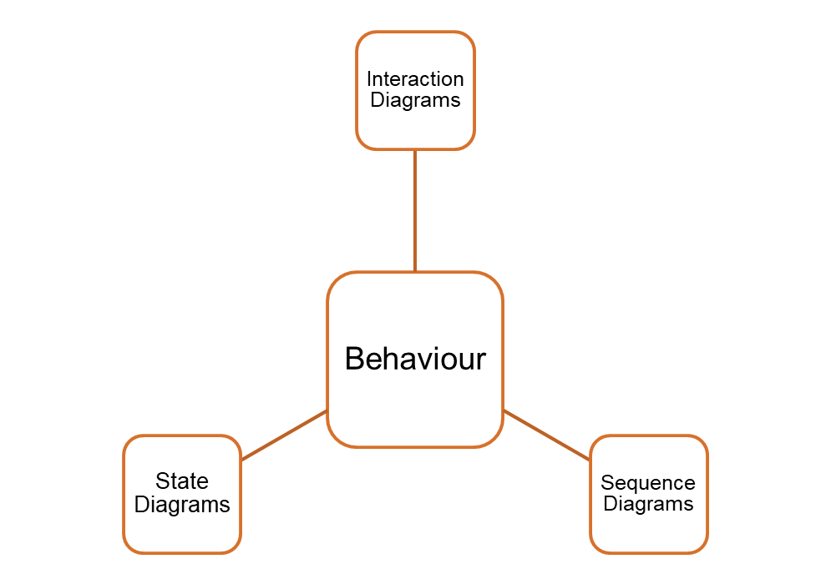
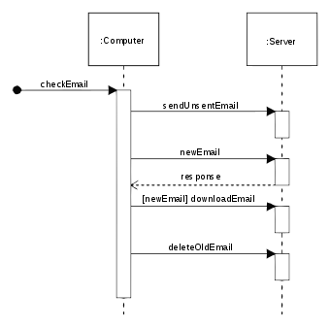
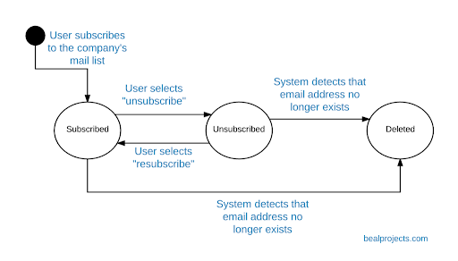
These slides are designed to accompany Software Engineering: A Practitioner’s Approach, 7/e (McGraw-Hill, 2009) Slides copyright 2009 by Roger Pressman.

Slide 10
Architecture & Design
These slides are designed to accompany Software Engineering: A Practitioner’s Approach, 7/e (McGraw-Hill, 2009) Slides copyright 2009 by Roger Pressman.

Slide 11
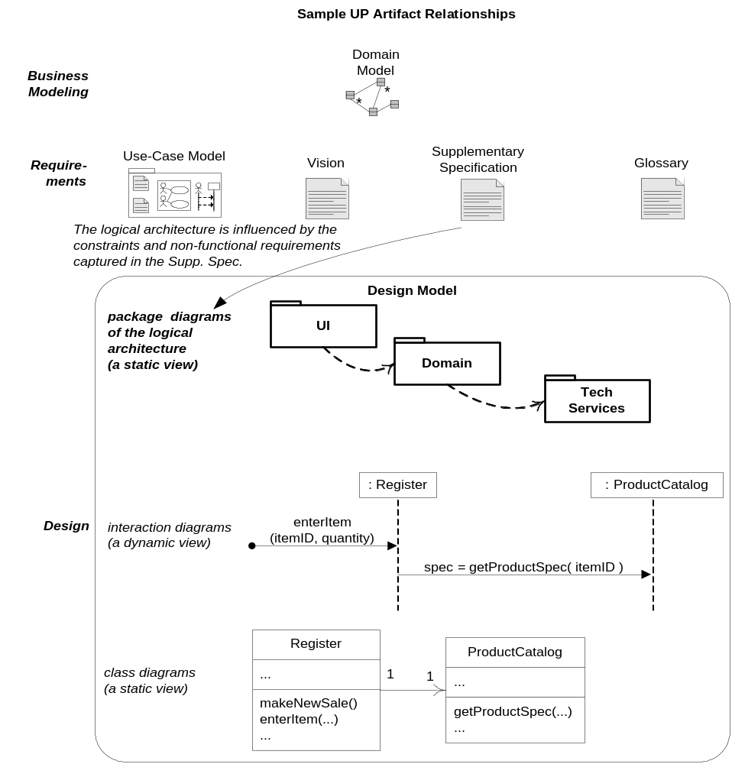

Slide 12
Different Design Aspects
  Architecture design:
    The division into subsystems and components,
      How these will be connected.
      How they will interact.
      Their interfaces.
  Class design:
    The various features of classes.
  User interface design
  Algorithm design:
    The design of computational mechanisms.
  Protocol design:
    The design of communications protocol.

Slide 13
What is Software Design?
A software design expresses a solution to a problem in programming language independent terms.
This permits a design to be implemented in any programming language.

Slide 14
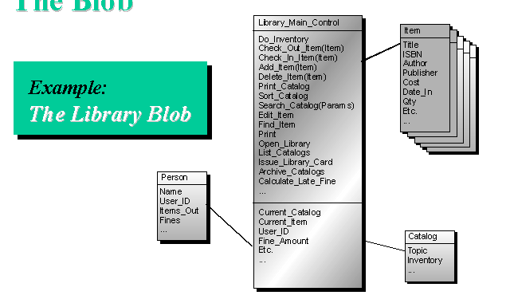
Simple Library system - Existing design
What areas do you see as potential problem areas? Why did you identify each of those areas?

Slide 15
Fundamental Concepts
Abstraction—data, procedure, control
Separation of concerns—any complex problem can be more easily handled if it is subdivided into pieces
Modularity—compartmentalization of data and function
Hiding—controlled interfaces
Refinement—elaboration of detail for all abstractions
Design Classes—provide design detail that will enable analysis classes to be implemented
Functional independence—High Cohesion and Low coupling
Patterns—”conveys the essence” of a proven design solution

Slide 16
Data Abstraction
door
manufacturer
model number
type
swing direction
inserts
lights
type
number
weight
opening mechanism
implemented as a data structure

Slide 17
Procedural Abstraction
open
details of enter
algorithm
implemented with a "knowledge" of the
object that is associated with enter

Slide 18
Separation of Concerns
Any complex problem can be more easily handled if it is subdivided into pieces that can each be solved and/or optimized independently
A concern is a feature or behavior that is specified as part of the requirements model for the software
By separating concerns into smaller, and therefore more manageable pieces, a problem takes less effort and time to solve.

Slide 19
Modularity
"modularity is the single attribute of software that allows a program to be intellectually manageable" [Mye78].
Monolithic software (i.e., a large program composed of a single module) cannot be easily grasped by a software engineer.
In almost all instances, you should break the design into many modules, hoping to make understanding easier and as a consequence, reduce the cost required to build the software.

Slide 20
Modularity: Trade-offs
What is the "right" number of modules for a specific software design?
module development cost
cost of
software
module
integration
cost
optimal number
number of modules
of modules

Slide 21
Information Hiding
module
• algorithm
controlled
interface
• data structure
• details of external interface
• resource allocation policy
clients
"secret"
a specific design decision

Slide 22
Why Information Hiding?
reduces the likelihood of “side effects”
limits the global impact of local design decisions
emphasizes communication through controlled interfaces
discourages the use of global data
leads to encapsulation—an attribute of high quality design
results in higher quality software

Slide 23
Stepwise Refinement
open
walk to door;
reach for knob;
open door;
repeat until door opens
turn knob clockwise;
walk through;
if knob doesn't turn, then
close door.
take key out;
find correct key;
insert in lock;
endif
pull/push door
move out of way;
end repeat

Slide 24
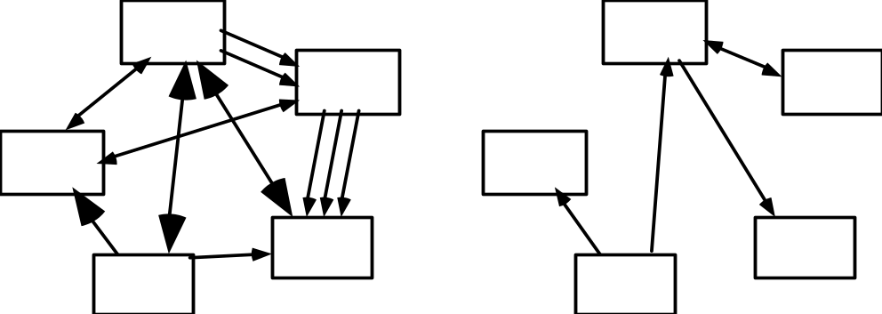
Coupling
Coupling occurs when there are interdependencies between one module and another
  When interdependencies exist, changes in one place will require changes somewhere else.
  A network of interdependencies makes it hard to see at a glance how some component works.

Slide 25
Revisting Library system - Existing design
What areas do you see as potential problem areas? Why did you identify each of those areas?

Slide 26
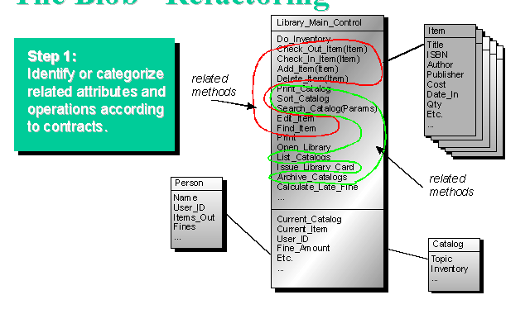
Library system – Changing the design

Slide 27
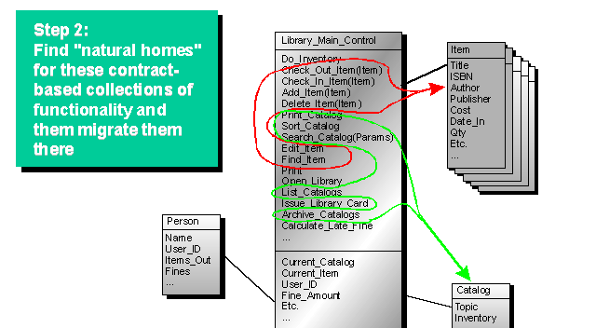
Library system – Changing the design

Slide 28
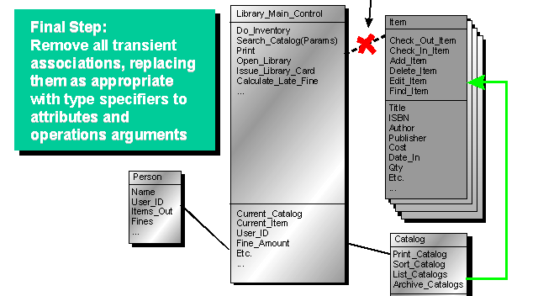
Library system – Changing the design

Slide 29
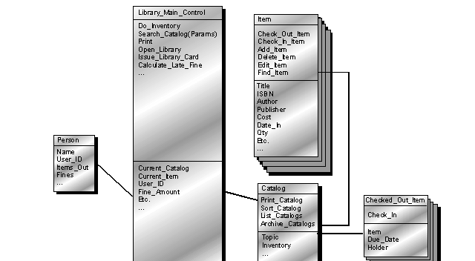
Library system – Changing the design

Slide 30
Design Patterns
Design Pattern Template
Pattern name—describes the essence of the pattern in a short but expressive name
Intent—describes the pattern and what it does
Also-known-as—lists any synonyms for the pattern
Motivation—provides an example of the problem
Applicability—notes specific design situations in which the pattern is applicable
Structure—describes the classes that are required to implement the pattern
Participants—describes the responsibilities of the classes that are required to implement the pattern
Collaborations—describes how the participants collaborate to carry out their responsibilities
Consequences—describes the “design forces” that affect the pattern and the potential trade-offs that must be considered when the pattern is implemented
Related patterns—cross-references related design patterns

Slide 31
Designing Classes
These slides are designed to accompany Software Engineering: A Practitioner’s Approach, 7/e (McGraw-Hill, 2009) Slides copyright 2009 by Roger Pressman.

Slide 32
Essentials of UML Class Diagrams
The main symbols shown on class diagrams are:
  Classes
      represent the types of data themselves
  Associations
      represent linkages between instances of classes
  Attributes
      are simple data found in classes and their instances
  Operations
      represent the functions performed by the classes and their instances
  Generalizations
      group classes into inheritance hierarchies

Slide 33
Classes
A class is simply represented as a box with the name of the class inside
  The diagram may also show the attributes and operations
  The complete signature of an operation is:
    operationName(parameterName: parameterType …): returnType
int
int
:void

Slide 34
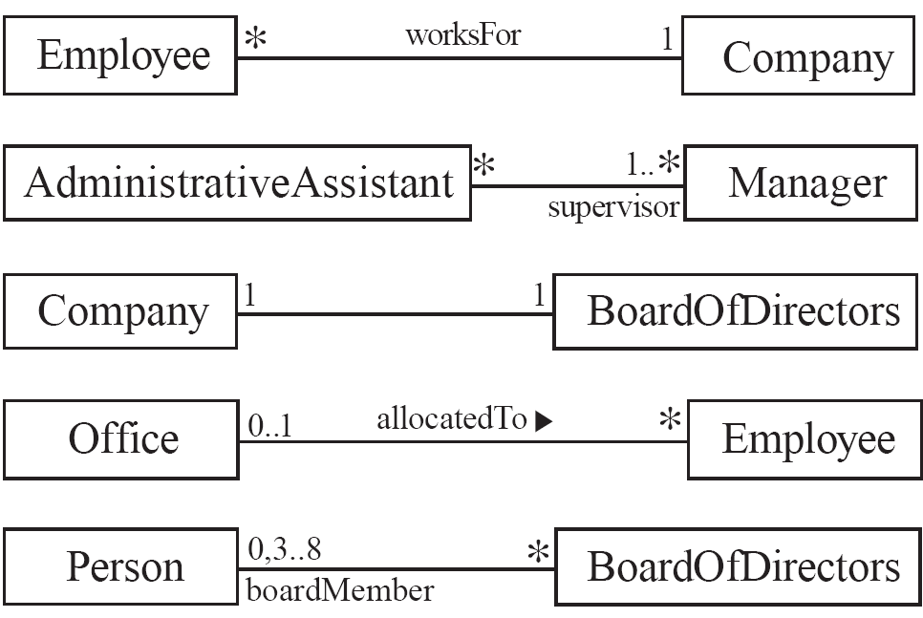
Associations and Multiplicity
  An association is used to show how two classes are related to each other
  Symbols indicating multiplicity are shown at each end of the association
  Each association can be labelled, to make explicit the nature of the association

Slide 35
Analyzing and validating associations
  Many-to-many
    A secretary can work for many managers
    A manager can have many secretaries
    Secretaries can work in pools
    Managers can have a group of secretaries
    Some managers might have zero secretaries.
    Is it possible for a secretary to have, perhaps temporarily, zero managers?

Slide 36
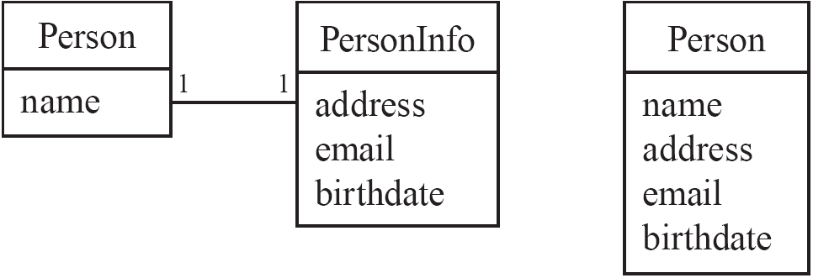
Analyzing and validating associations
Avoid unnecessary one-to-one associations
Avoid this do this

Slide 37
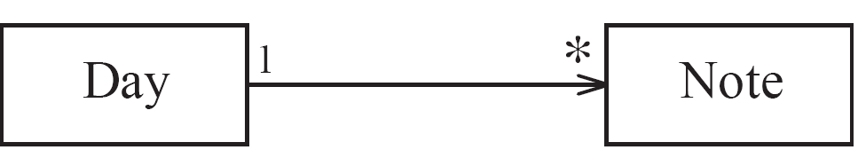
Directionality in associations
Associations are by default are undefined, though many tools treat these as bi-directional.
It is possible to limit the direction of an association by adding an arrow at one end

Slide 38
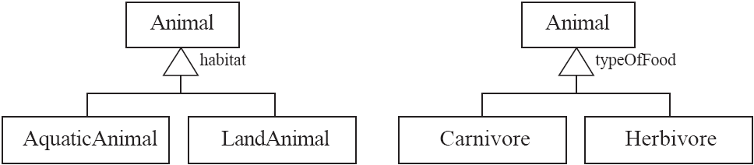
Generalization
Specializing a superclass into two or more subclasses
  The discriminator is a label that describes the criteria used in the specialization

Slide 39
Associations versus generalizations in object diagrams
  Associations describe the relationships that will exist between instances at run time.
    When you show an instance diagram generated from a class diagram, there will be an instance of both classes joined by an association
  Generalizations describe relationships between classes in class diagrams.
    They do not appear in instance diagrams at all.
    An instance of any class should also be considered to be an instance of each of that class’s superclasses

Slide 40
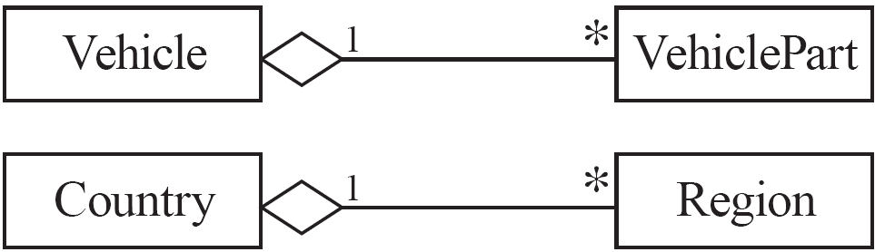
More Advanced Features: Aggregation
  Aggregations are special associations that represent ‘part-whole’ relationships.
    The ‘whole’ side is often called the assembly or the aggregate
    This symbol is a shorthand notation association named isPartOf
As a general rule, you can mark an association as an aggregation if the following are true:
  You can state that
    the parts ‘are part of’ the aggregate
    or the aggregate ‘is composed of’ the parts
  When something owns or controls the aggregate, then they also own or control the parts

Slide 41
Interfaces
An interface describes a portion of the visible behaviour of a set of objects.
  An interface is similar to a class, except it lacks instance variables and implemented methods
Person
«interface»
Cashier
Machine
Person
Machine
withdraw
deposit
Cashier
Cashier
Employee
ATM
Employee
ATM

Slide 42
Suggested sequence of activities
  Identify a first set of candidate classes
  Add associations and attributes
  Find generalizations
  List the main responsibilities of each class
  Decide on specific operations
  Iterate over the entire process until the model is satisfactory
    Add or delete classes, associations, attributes, generalizations, responsibilities or operations
    Identify interfaces
    Apply design patterns
    Don’t be too disorganized. Don’t be too rigid either!

Slide 43
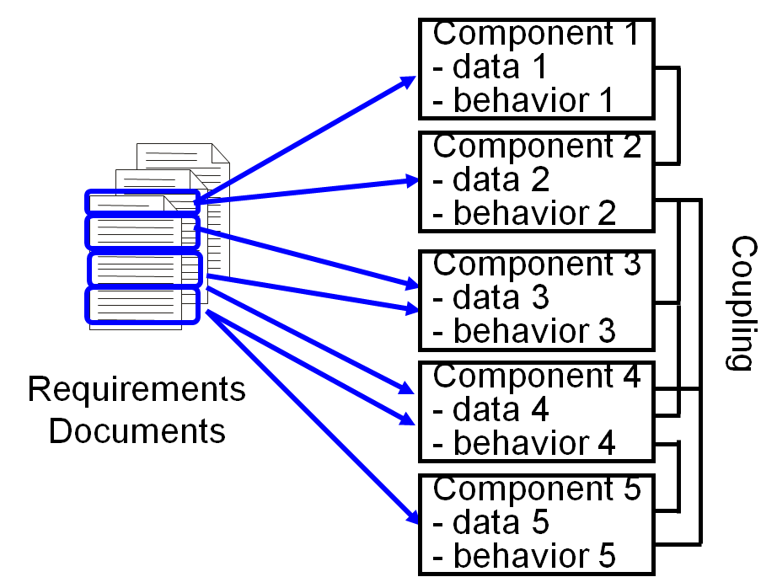
Mapping Requirements to Design Components
Design must satisfy requirements
  Everything (data and behavior) in the requirements must be mapped to the design components
  Decide what functionality goes into which component
As you do the mapping, assess functional cohesion and coupling
  Strive for low coupling and high cohesion

Slide 44
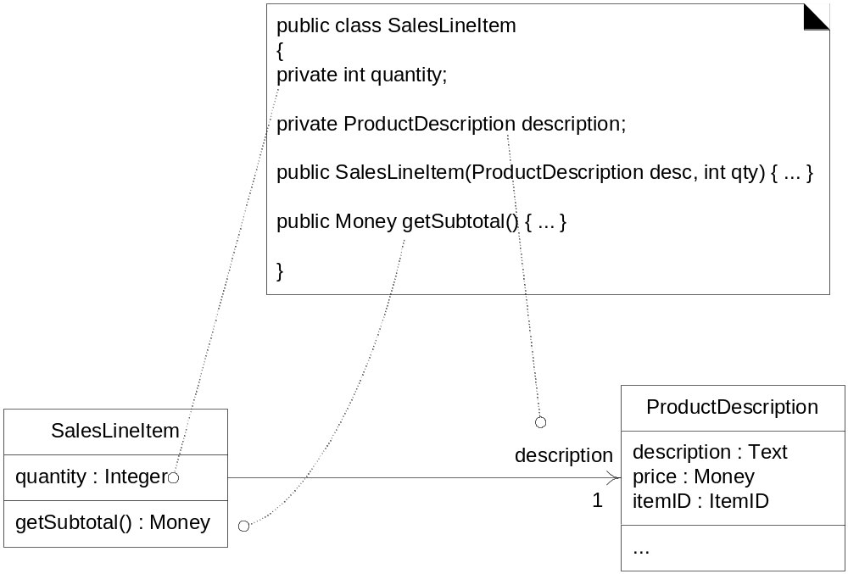
Mapping UML class diagram to code

Slide 45
UML Behavioral Models

Slide 46
Specifying behavior using the UML
Class models describe objects and their relationships
  Behavior can be specified in terms of operation pre and postconditions, but behavior is not the primary focus of a class model
Behavioral models in the UML
  State diagrams: describe control aspects of a system – provides descriptions sequences of operations without regard for what the operations do.
  Interaction models (Sequence diagrams): describe interactions among objects

Slide 47
How Things Happen in UML
In UML, all behavior results from the actions of (active) objects
Obj1
Obj1
Obj2
Obj1
Obj2
Obj1
Obj1
Obj2
Obj2
Obj2
Object
behavior
(e.g., statechart)
s1
s1
s1
s1
s1
s1
s1
s1
s1
s1
s2
s2
s2
s2
s2
s2
s2
s2
s2
s2
Obj3
Obj3
Obj3
Obj3
Obj3
s1
s1
s1
s1
s1
s2
s2
s2
s2
s2
Inter-object
behavior
(e.g., Sequence)

Slide 48
Interaction Diagrams
Interaction diagrams are used to model the dynamic aspects of a software system
  They help you to visualize how the system runs.
  An interaction diagram is often built from a use case and a class diagram.
    The objective is to show how a set of objects accomplish the required interactions with an actor.

Slide 49
Interactions and messages
  Interaction diagrams show how a set of actors and objects communicate with each other to perform:
    The steps of a use case, or
    The steps of some other piece of functionality.
  The set of steps, taken together, is called an interaction.
  Interaction diagrams can show several different types of communication.
    E.g. method calls, messages send over the network
    These are all referred to as messages.

Slide 50
Elements found in interaction diagrams
  Instances of classes
    Shown as boxes with the class and object identifier underlined
  Actors
    Use the stick-person symbol as in use case diagrams
  Messages
    Shown as arrows from actor to object, or from object to object

Slide 51
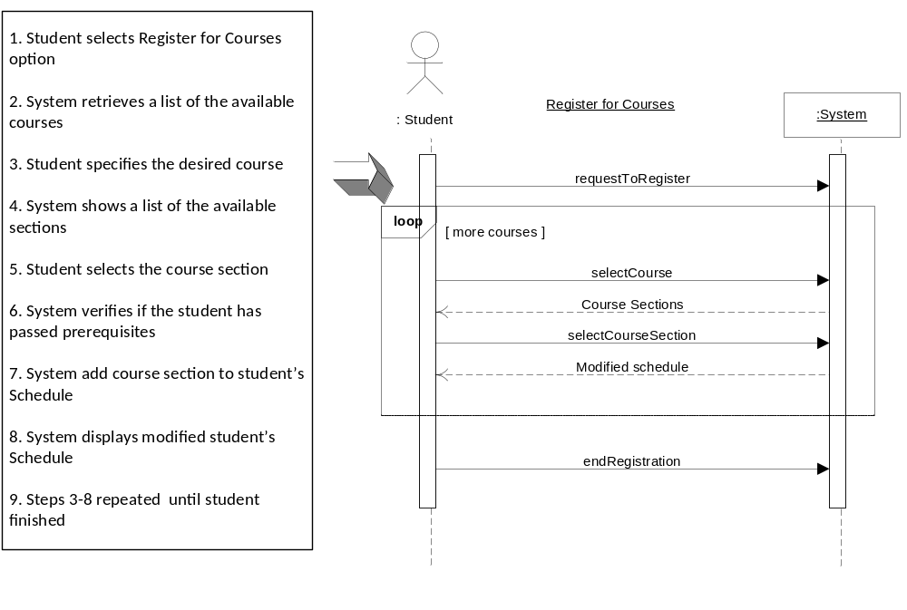
Sequence Diagrams – Modeling Interaction
Based on System Sequence Diagrams
Larman, C. Applying UML and Patterns, 3rd Edition (Pearson Education, 2005)

Slide 52
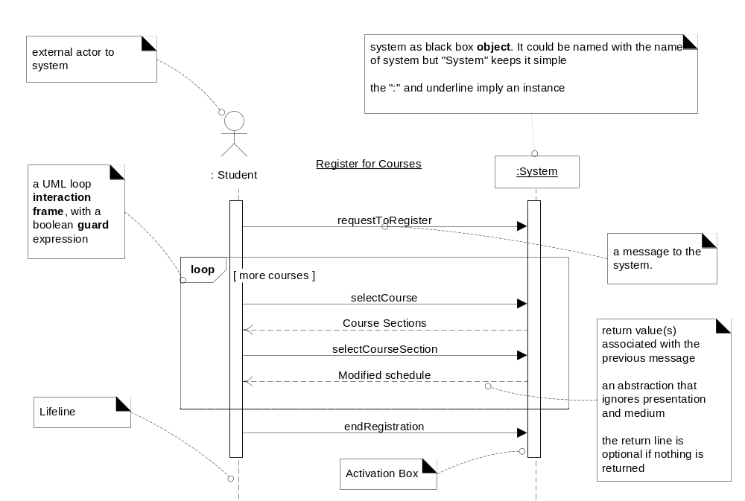
Sequence Diagrams – Elements

Slide 53
Sequence diagrams
A sequence diagram shows the sequence of messages exchanged by the set of objects performing a certain task
  The objects are arranged horizontally across the diagram.
  An actor that initiates the interaction is often shown on the left.
  The vertical dimension represents time.
  A vertical line, called a lifeline, is attached to each object or actor.
  The lifeline becomes a broad box, called an activation box during the live activation period.
  A message is represented as an arrow between activation boxes of the sender and receiver.
    A message is labelled and can have an argument list and a return value.

Slide 54
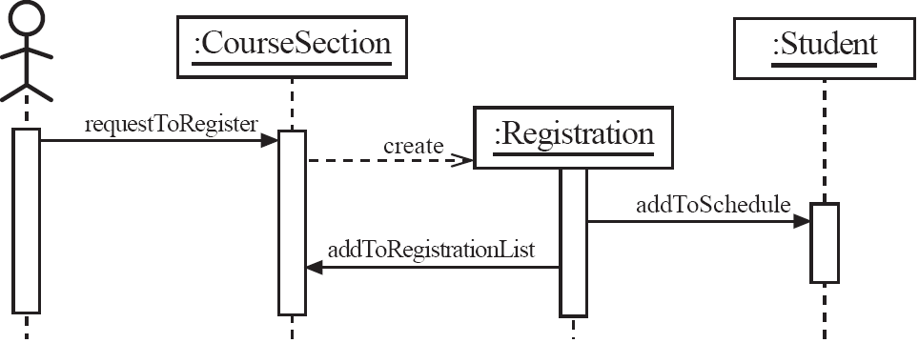
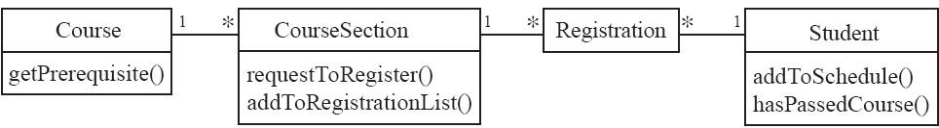
Sequence diagrams – an example

Slide 55
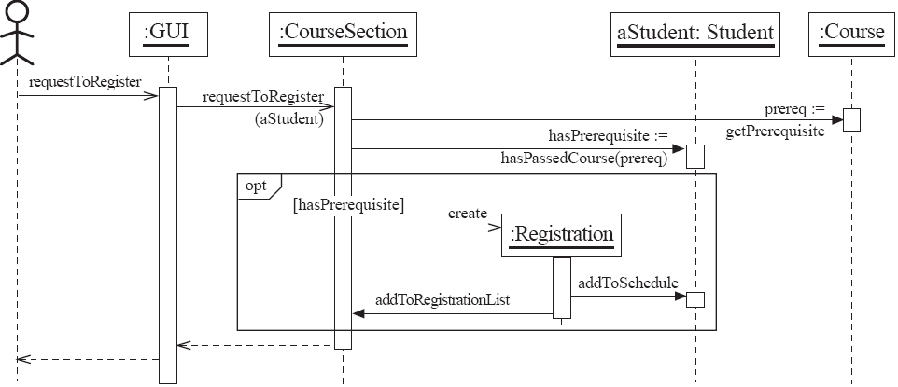
Sequence diagrams – same example, more details

Slide 56
State diagrams

Slide 57
State diagrams
A state diagram specifies the life histories of objects in terms of the sequences of operations that can occur in response to external stimuli.
  For example, a state diagram can describe how an object responds to a request to invoke one of its methods.
A state diagram describes behavior in terms of sequences of states that an object can go through in response to events.

Slide 58
Key Concepts
An event is a significant or noteworthy occurrence at a point in time.
  Examples of events: sending a request to invoke a method, termination of an activity.
  An event occurs instantaneously in the time scale of an application.
A state is a condition of an object during its lifetime.
  For example, a student is in the registered state after completing course registration.
  A state is an abstraction of an object’s attribute values and links
    For example, a bank account is in the Overdraft state when the value of its balance attribute is less than 0.

Slide 59
Key Concepts - 2
A transition occurs when an event causes an object to change from its current (source) state to a target state.
  For example, if a student is in the registered state and then drops out of the program then the student is in the “not registered” state.
  The source and target states can be the same.
  A transition is said to fire when the change from source to target state occurs.
A guard condition on a transition is a boolean expression that must be true for a transition to fire
An activity is a behavior that is executed in response to an event.

Slide 60
Basic UML State Diagram
“top” state
State
Initial
state
top
Event
Ready
Transition
stop
/ctr := 0
Done
Final
state
Activity
stop

Slide 61
Simple Example: Telephone Object
initial state
Idle
state
event
lift receiver/ get dial tone
caller hangs up / disconnect
When the object is created, it moves into the Idle state.
If a “lift receiver” event is received the object moves from the Idle to the Active state. During the transition the “get dial tone” activity is executed.
If a “caller hangs up” event occurs when in Active state, the object moves to the Idle state and the “disconnect” activity is performed during the transition.
Active
Activity that is performed during transition: it executes instantaneously

Slide 62
Guards
Conditional execution of transitions
  guards (Boolean predicates) must be side-effect free
bid [value < 100] /reject
Selling
bid [value >= 200] /sell
Happy
bid [(value >= 100) & (value < 200)] /sell
Unhappy

Slide 63
TV - Example
TVOFF
Turn on[vcr in OFF]/turn display on ^vcr.standby
TVON

Slide 64
Protocol State Machines
Equivalent to pre and post conditions added to the related operations:
  takeOff()
    Pre
      in state "checked"
      cleared for take off
    Post
      landing gear is retracted
      in state "flying"
onGround
check()
checked
[cleared for take off]
takeOff()
/[landing gear is retracted]
flying
land()
postcondition
instead of action

Slide 65
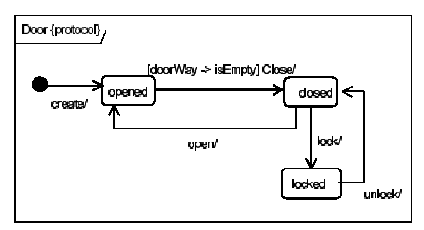
Another Example of a Protocol State Machine

